Slide 1
Get To Know My Hometown - Radom
Author: Izabela Radomska
Prezentacja podsumowująca projekt stypendialny

Slide 2
Projekt powstał dzięki ”Mazowieckiemu programowi stypendialnego dla uczniów szczególnie uzdolnionych – najlepsza inwestycja w człowieka”

Slide 3
Radom is a medium sized city which is located near Warsaw – the capital of Poland. There are almost 200 000 people living here.
Let me show you then the most beutiful places in my city to convince you to see them on your own.

Slide 4
To show better understanding why I chose this places I asked 60 people of any age to choose the most beautiful places in Radom.
The result is shown on a diagram based on a poll I’ve done before. Majority of them chose ’Muzeum Wsi Radomskiej’ – 35%.

Slide 5
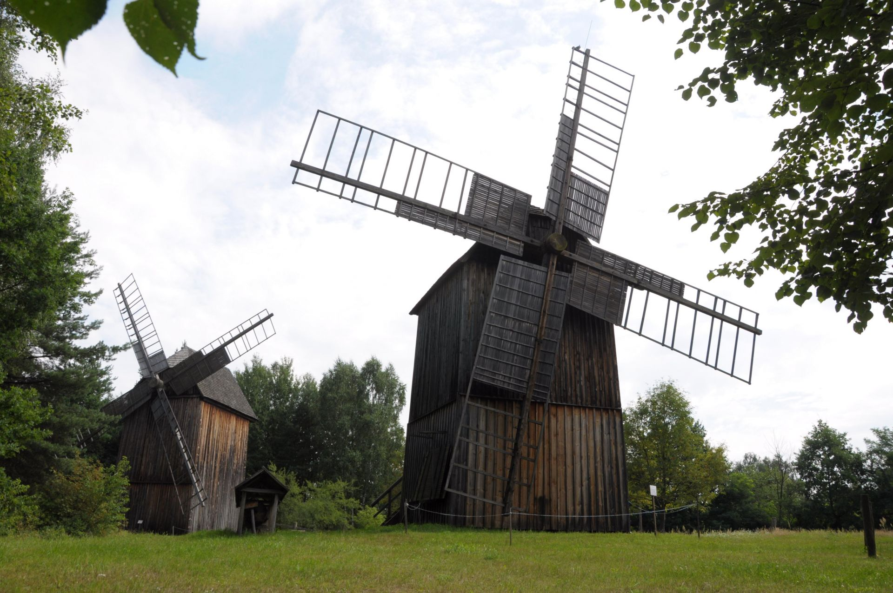
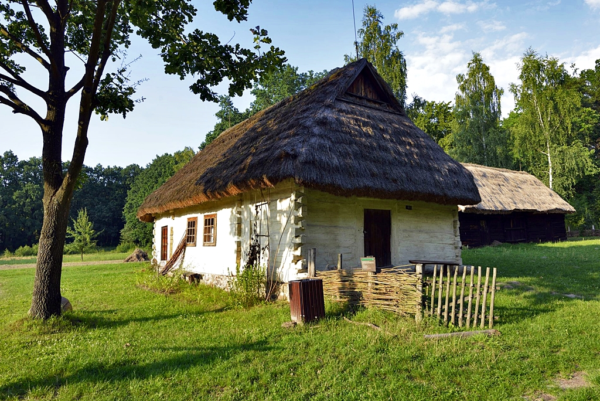
’MUZEUM WSI RADOMSKIEJ’
It’s one of the most interesting places in my town. Not only can you see where our anesors were living in te past but also admire beautiful culture. Houses, farms, windmills – everything is kept exactly as it was before.

Slide 6
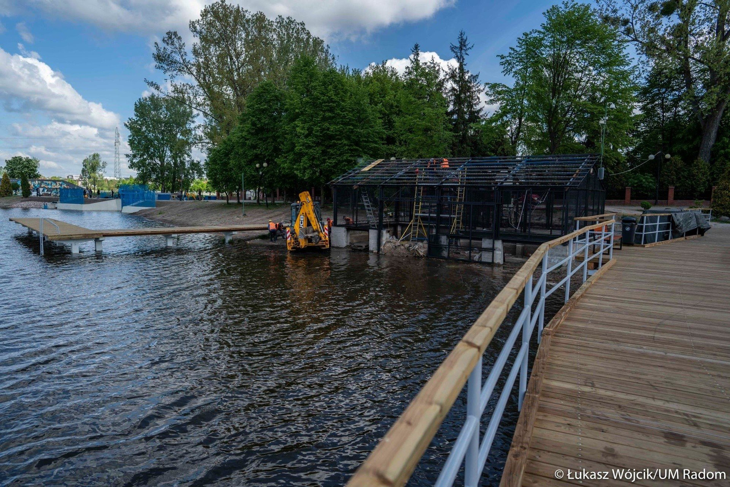
’ZALEW BORKI’
This is the best place for walks especially in summer. Since there is water and lifeguards you can spend your entire day swimming. If you want, you also can buy there food.
For those who has kids there are playgrounds too.
You can also check on the internet if there’s any event you can attend such as concerts or festivals.

Slide 7
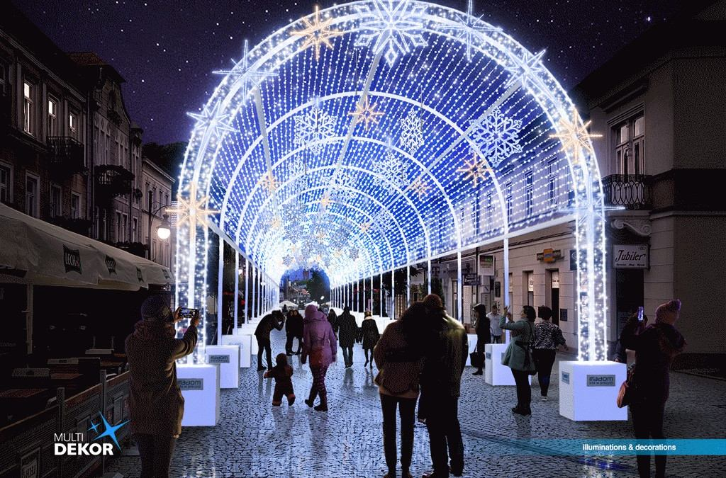
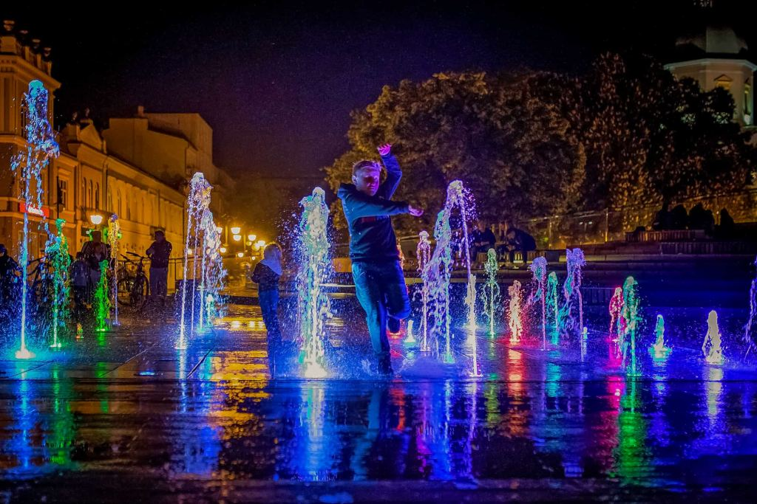
ŻEROMSKIEGO STREET
This place is perfect for a meeting spot, there is plenty of restaurants, bars or even pubs to visit. This place surrounded by lights creates the magical place to spend you evenings either with family or friends.

Slide 8
AIRPORT WARSAW - RADOM
The airport is the newest place in Radom. It was build recently and since then it only gaining more and more popularity. Even recently there have been a well known Air Show which brought the whole country to Radom.

Slide 9
Sources and photos
https://podroze.onet.pl/polska/mazowieckie/radom-atrakcje-zabytki-ciekawe-miejsca-co-warto-zobaczyc-podpowiadamy/sh8zky8
https://www.cozadzien.pl/kultura/skad-wziela-sie-nazwa-radom/78988
https://www.muzeum-radom.pl/wystawy-stale/zespol-wiatrakow/603
https://wirtualnynowydwor.pl/muzeum-wsi-radomskiej/
https://www.visitradom.pl/deptak-zeromskiego/#
https://echodnia.eu/radomskie/budowa-zalewu-na-borkach-w-radomiu-konczy-sie-napelnianie-zbiornika-woda-kiedy-bedzie-mozna-sie-kapac-wideo-duzo-zdjec/ar/c1-15622454
https://radom.wyborcza.pl/radom/7,48201,29961898.html
https://pl.wikipedia.org/wiki/Radom
https://polskieradio24.pl/5/1222/artykul/3230952,drugi-dzien-air-show-radom-2023-transmisja-na-stronach-polskiego-radia

Slide 10
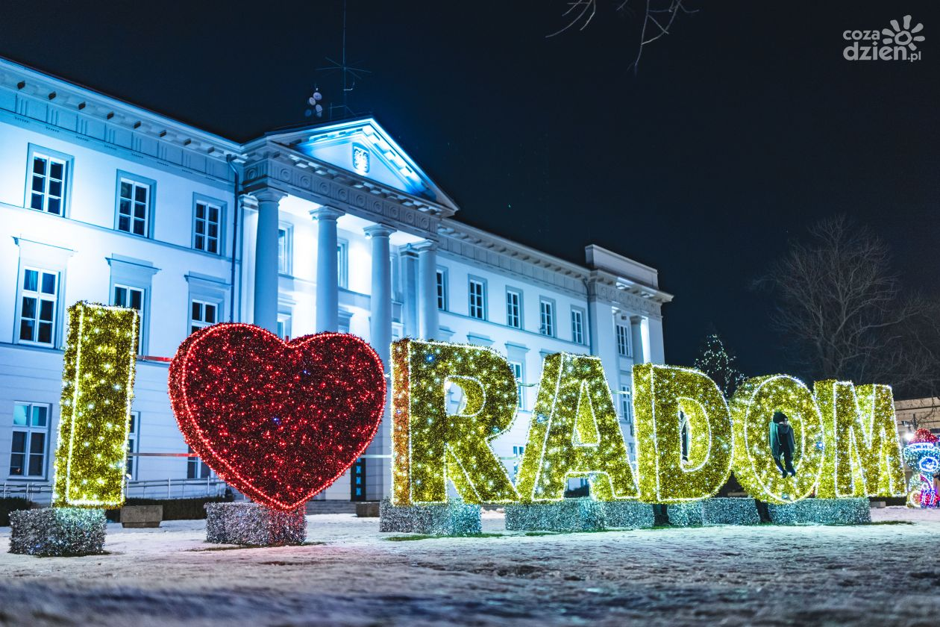
Thank you for listening and I hope that one day you will visit Radom and see this beautiful city with your own eyes!

